Slide 1
Software Project
Lecturer: Ngo Huy Bien
Software Engineering Department
Faculty of Information Technology
VNUHCM - University of Science
Ho Chi Minh City, Vietnam
nhbien@fit.hcmus.edu.vn

Slide 2

Objectives
To communicate in project management area.
To explain why projects fail.
To explain project constrains.
To propose a project idea.
To evaluate a project idea.

Slide 3

Contents
Software.
Project.
Project scope & product scope.
Project types.
Project failure reasons.
Project constraints.

Slide 4

References
Project Management Institute (2017). A Guide to the Project Management Body of Knowledge. 6th Edition.
Kim Heldman (2018). PMP Project Management Professional Study Guide. Sybex.
Capers Jones (2018). Software Methodologies: A Quantitative Guide. Auerbach Publications.
William Trochim and James P. Donnelly (2007). The Research Methods Knowledge Base.
Robert N. Charette (2005). Why Software Fails. IEEE Spectrum.
Kathy Schwalbe (2017). An Introduction to Project Management. 6th Edition.

Slide 5
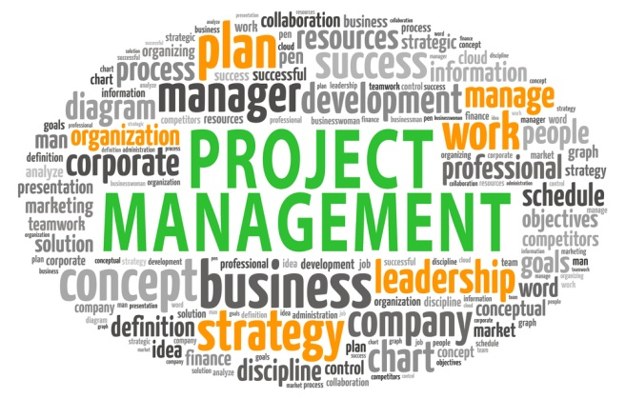

Foundation for Communication

Slide 6
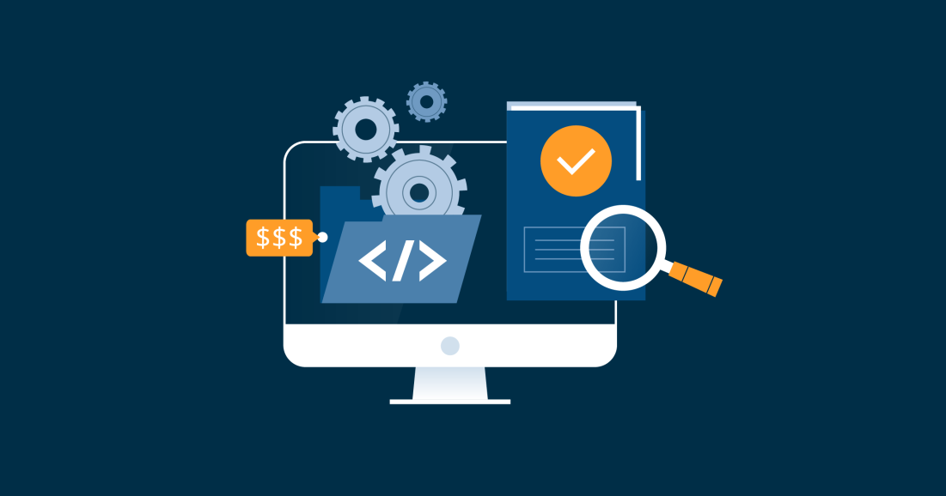
Software
Why care about software definition?

Slide 7
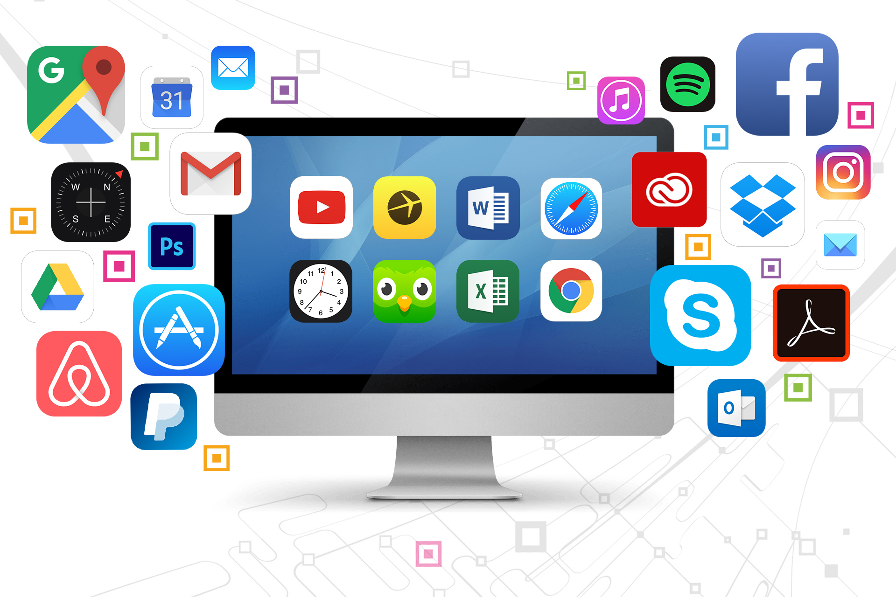
Software Types
Why care about software types?

Slide 8
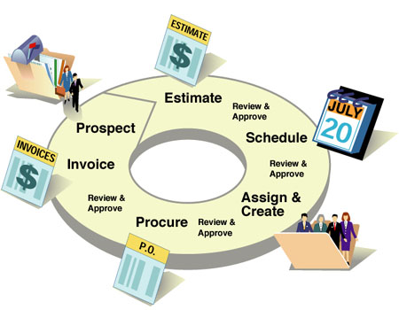
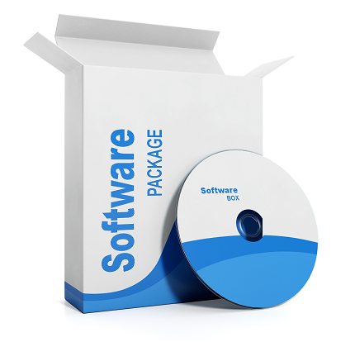
Project [1]
A project is a temporary endeavor undertaken to create a unique product, service, or result.
Temporary
Temporary
Budget
Effort
Requirements, Scope
Temporary
Schedule
Unique product, service, or result
Duration
(Start Date
End Date)
Cost
Temporary
Products, Deliverables
Resource
Notes:
Software is the result of a software development process (a project result).
Unique: No two projects will be identical, although they may be similar.

Slide 9
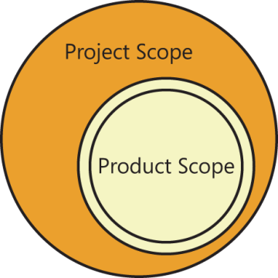

Product Scope vs. Project Scope
In the project context, the term scope can refer to:
Product scope. The features and functions that characterize a product, service, or result; and/or
Project scope. The work performed to deliver a product, service, or result with the specified features and functions.
The term project scope is sometimes viewed as including product scope.

Slide 10

Management
Ad-hoc management.
Systematic management.

Slide 11

Where Do Projects Come From? [4]
The requests for proposals (RFPs) that are published by government agencies and some organizations.
Research projects and products
The literature in specific field.
The most common sources of projects is the experience of practical problems in the field.
Many people simply think up their project on their own that are influenced by their background, culture, education, and experiences.

Slide 12


Requests for Proposals
Client → Budgets.
Management, employees, sales, marketing, support, customer service
→ Business process automation, bugs, specific requirements → RFP.
Relationship with government agencies and organizations.
Experiences in the field.

Slide 13
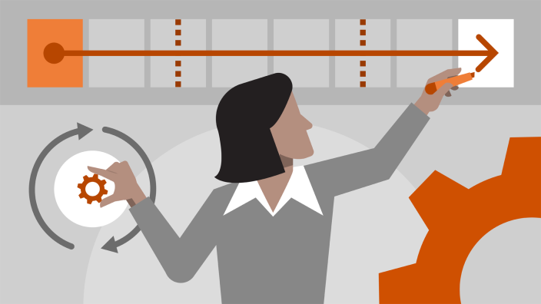
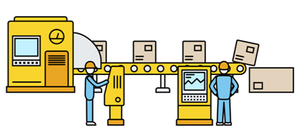
Operations and Projects [2]
Projects are temporary in nature and have definitive start dates and definitive end dates, use original processes, produce unique results.
Operations are ongoing and repetitive, use the same processes, produce the same results.
Project may come from the need of operations improvement.

Slide 14
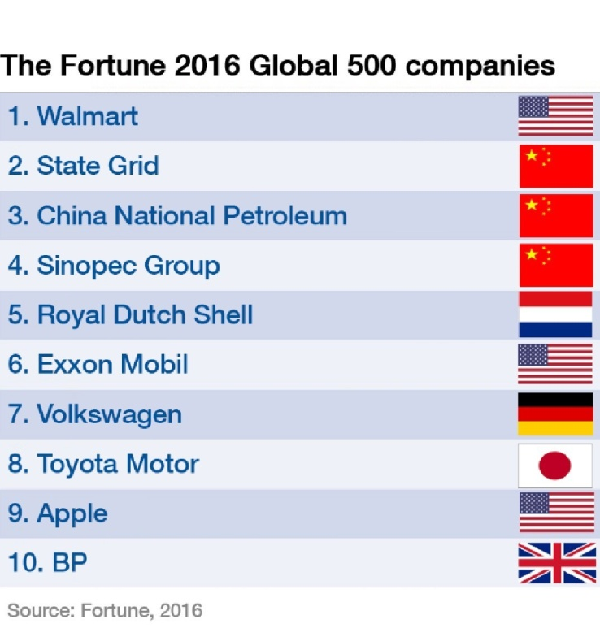
Software Project Types [3]
Type of Project | Number
Legacy enhancements | 22
New development | 7
ERP modifications | 12
Legacy renovations | 4
COTS modifications | 16
Open-source modifications | 3
Legacy repairs | 30
Cyber-attack recovery | 6
Total | 100
A modern mix
of 100 software projects in a Fortune 500 company

Slide 15


Research Project
Why: Organization → Productivity, business competitiveness and opportunities.
Why: Group or individuals → Business opportunities.
Where: Literature, Practical problems, Creativity

Slide 16

Freelance Projects

Slide 17

Software Development Competitions

Slide 18
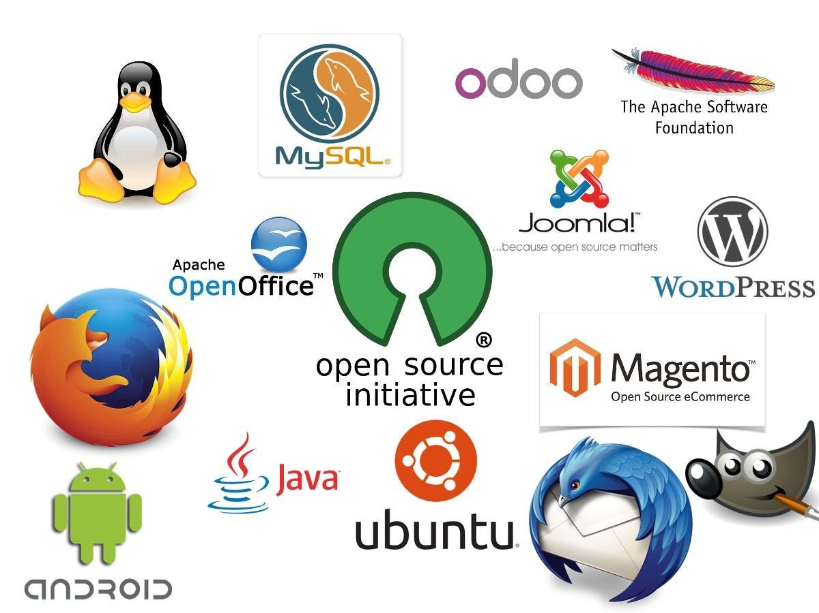
Open Source Projects

Slide 19

Projects, Programs, and Portfolio [2]
Programs are groups of related projects that are managed using the same techniques in a coordinated fashion.
Portfolios are collections of programs and projects that meet a specific business goal or objective.

Slide 20
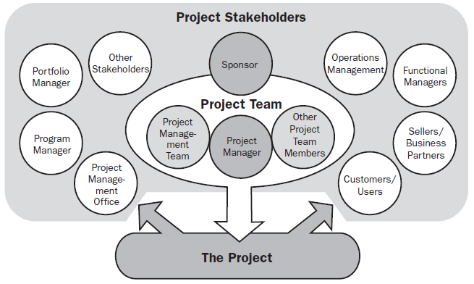
Stakeholders [1]
Stakeholders are persons or organizations (e.g., customers, sponsors, the performing organization, or the public), who are actively involved in the project or whose interests may be positively or negatively affected by the performance or completion of the project.
High-level governance of a collection of projects or programs, which may or may not be interdependent
Human resources, finance, accounting, procurement
Managing related projects

Slide 21

Why Clarify Stakeholders?
Everyone brings something unique to the team.
Contracts haven't been confirmed.
Equipment hasn't been delivered on time.
Budgets are behind.
There's no decision-maker.

Slide 22
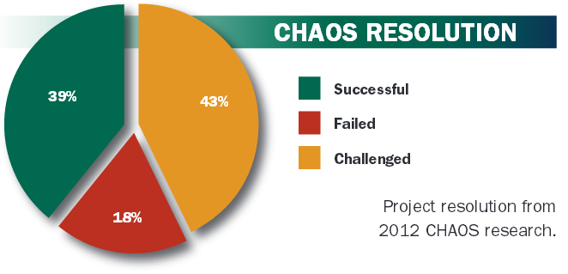
Projects Success and Failure
Success: The project is completed on time and on budget, with all features and functions originally specified and the customer is happy.
Challenged: The project is completed and operational, but over budget, late, and with fewer features and functions than initially specified.
Failure: The project is canceled before completion, or delivered and never used.

Slide 23
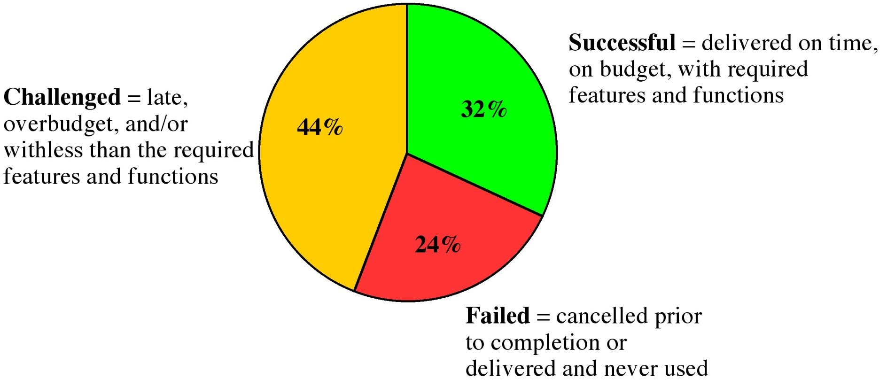
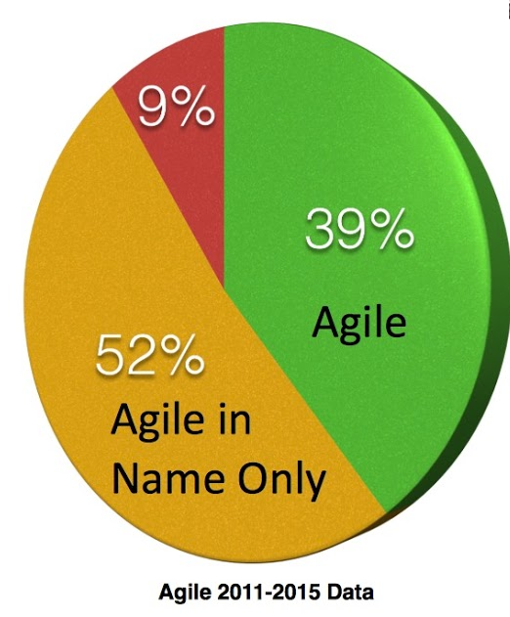
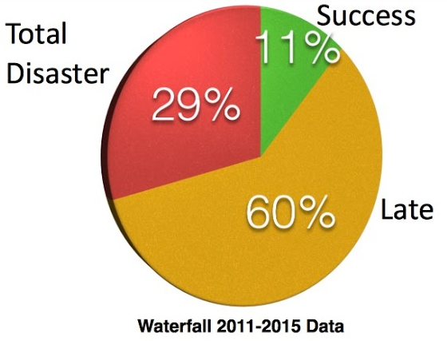

What Went Wrong?

Slide 24
Causes of Project Failure
Clear Objectives
Unclear Methods
Unclear Objectives
Unclear Methods
Unclear Objectives
Clear Methods
Clear Objectives
Clear Methods

Slide 25

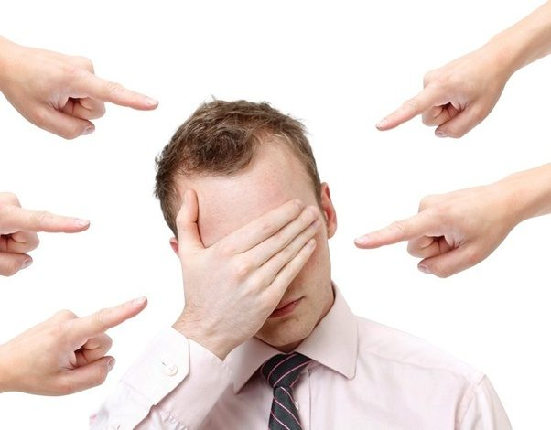
Why Do Projects Fail? [5]
Unrealistic or unarticulated project goals
Poor communication among customers, developers, and users
Inaccurate estimates of needed resources
Poor reporting of the project's status
Use of immature technology
Inability to handle the project's complexity
Sloppy development practices
Badly defined system requirements
Poor project management
Unmanaged risks
Constant change of requirements
Stakeholder politics
Commercial pressures

Slide 26


We Have To Ensure That [1]
The project will be within cost.
The project will be delivered on time.
The project will be within scope.
The project will meet our customer's quality requirements.
Our customer will be happy.

Slide 27
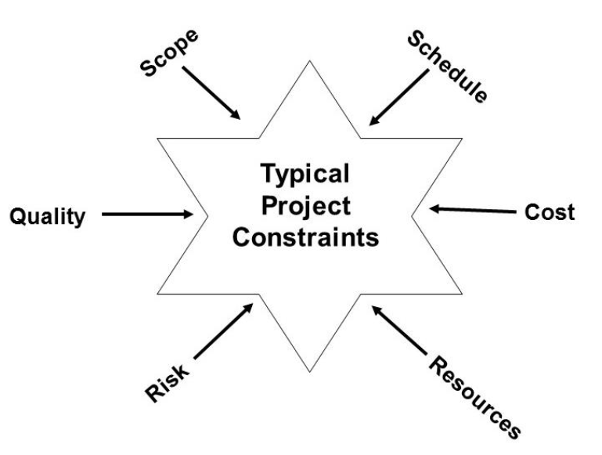
Managing Constraints [6]
Every project is constrained in different ways.
You must decide which constraints are most important on each particular project.
Time
Development is a triangle:
good, fast, cheap – pick any two.
Notes:
Why should project be in control?

Slide 28



But How? Where Do We Start?

Slide 29

Thank You & See You Again

